Slide 1


Develop AI and ML frameworks/models to automate the university application process
Group – 12
Niren Patel
Shashank Tripathi
Tanmay Daulatwal
Nitin Singh Rana

Slide 2

Introduction
The world is undergoing a digital transformation, and education sector is no exception. Technological advancements are rapidly changing the way we learn, teach and interact with educational institutions. However, despite the advancement’s, universities and colleges face several challenges, particularly during student admissions.

Slide 3
Application process is a steppingstone in education journey of every student. However, it is a complex and time-consuming task for universities and colleges. Automation has the potential to revolutionize the way universities and colleges handle the process.
Traditional process involves evaluating thousands of applications , requires a lot of manual work and can take weeks, if not months to complete. Moreover, it is prone to human errors and biases, leading to an unfair and inconsistent evaluation of applicants.
This is where automation comes into play. By automating the application admission process , colleges and universities can streamline the entire process effectively and can further reduce the time and effort required.

Slide 4
Problem Statement
To create an AI and ML-based system that can automate the university application process, including challenges like gathering and processing applicant information, producing individualized recommendations for colleges and programs, and managing communication with applicants and universities.
OCR, voice recognition, and face detection technologies will be used to achieve this goal.
The software will extract data from marksheets using OCR, set up automated interviews, and suggest the best-fit candidates for individual programs using face detection and voice recognition technologies. The solution will be cloud-based and provided as an API that can be integrated into colleges and universities’ systems.

Slide 5
Problem Statement
Universities are increasingly struggling to handle the admission process effectively due to the advancement of technology and rise in student enrolment.
This is where machine learning (ML) and artificial intelligence (AI) may be used to automate the admissions process and make it more effective and can help in a well-informed data driven decision making.
The team worked in collaboration with Edmission Inc.

Slide 6
Why ?
The project will benefit multiple stakeholders involved in the admission process.
First and foremost, the project will benefit the student applicants, who will experience a faster, more efficient and streamlined admission process.
Secondly, it will also benefit the administrative staff of colleges and universities for they will enjoy reduced administrative burden and improved accuracy in the decision-making process.
Finally, the project will benefit the colleges and universities, enhancing its reputation and competitiveness by providing a modern, streamlined and efficient admission process. This can lead to an increased student enrollments, improved retention rates, and ultimately increasing revenue.

Slide 7
Data Collection
Web scraping, also known as web data extraction, is the process of automatically gathering and extracting data from websites. This is done by using software tools to access and download information from web pages, which can then be transformed into a usable format for analysis. Web scraping is commonly used for a variety of applications, including market research, competitor analysis, content aggregation, and price monitoring. However, it is important to note that not all web scraping is legal, as some websites prohibit or restrict access to their data. Therefore, it is essential to follow ethical and legal guidelines when engaging in web scraping activities.

Slide 8
Dataset Information
The data collected for Ten universities and colleges contains information required for university application process. Data was collected manually from official websites of the colleges and universities.
Data collected has following variables like ID, Program Level, Program Name, School Name, Location, Tuition Fees, Application Fees, University Page url.
Data was collected for colleges and universities like Conestoga College, Ontario-tech University, Yorkville University, Sault College. Program level was further subcategorized as graduate, diploma, masters etc.. The data was collected for international students.

Slide 9
Dataset Information
The information collected is believed to be highly accurate, complete, and comprehensive as it was sourced directly from the institution’s official websites.

Slide 10
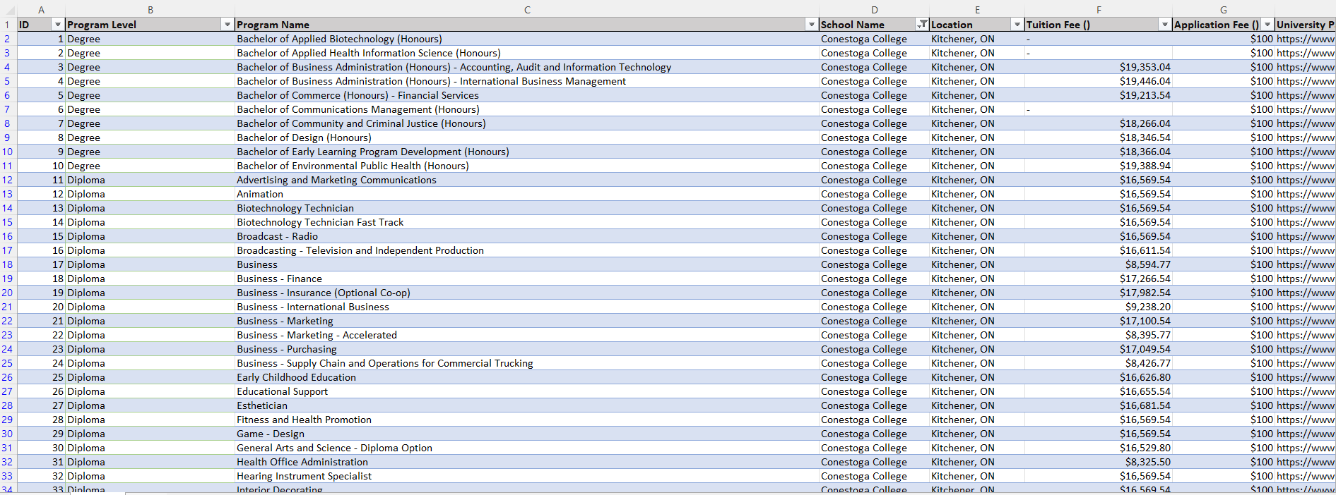

Data Sample

Slide 11


Visualization

Slide 12
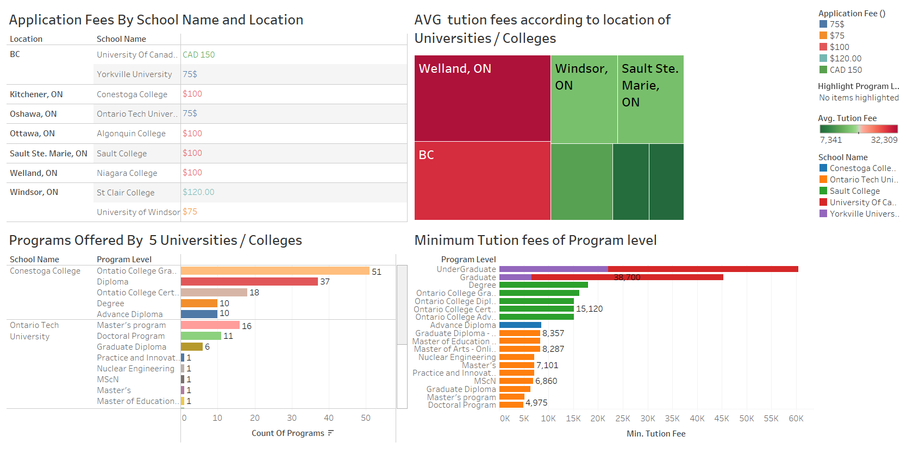
Dashboard

Slide 13
Voice Recognition Technology and Its Role

Slide 14
Voice recognition technology will be used to capture and transcribe interview responses from candidates.
The voice recognition engine will be trained to recognize different accents and speech patterns to ensure accurate transcription.
The transcribed data will be analyzed to identify strengths and weaknesses of candidates, which will be used in the selection process.

Slide 15
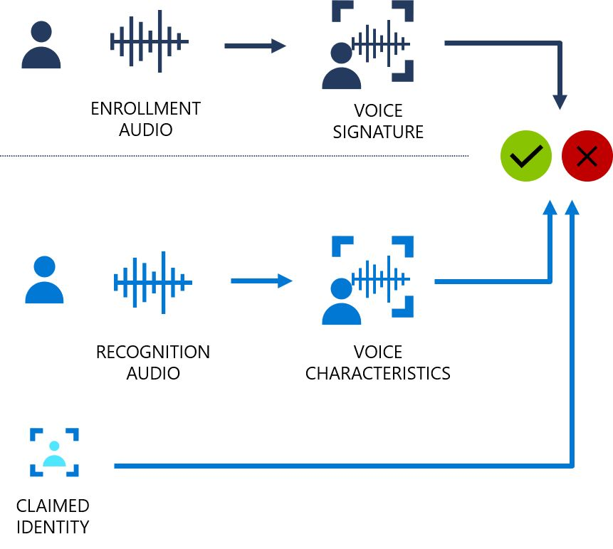
Process Flow Diagram
Library: We have used speech recognition and pyttsx3 in this project.
This project is built on google API and we are sending our voice byte data to google API integrated in our application.
Converting the output into text using pyttsx3 from speech recognition which is coming in byte format.
Saving the output into the text file using pandas and NUMPY.

Slide 16
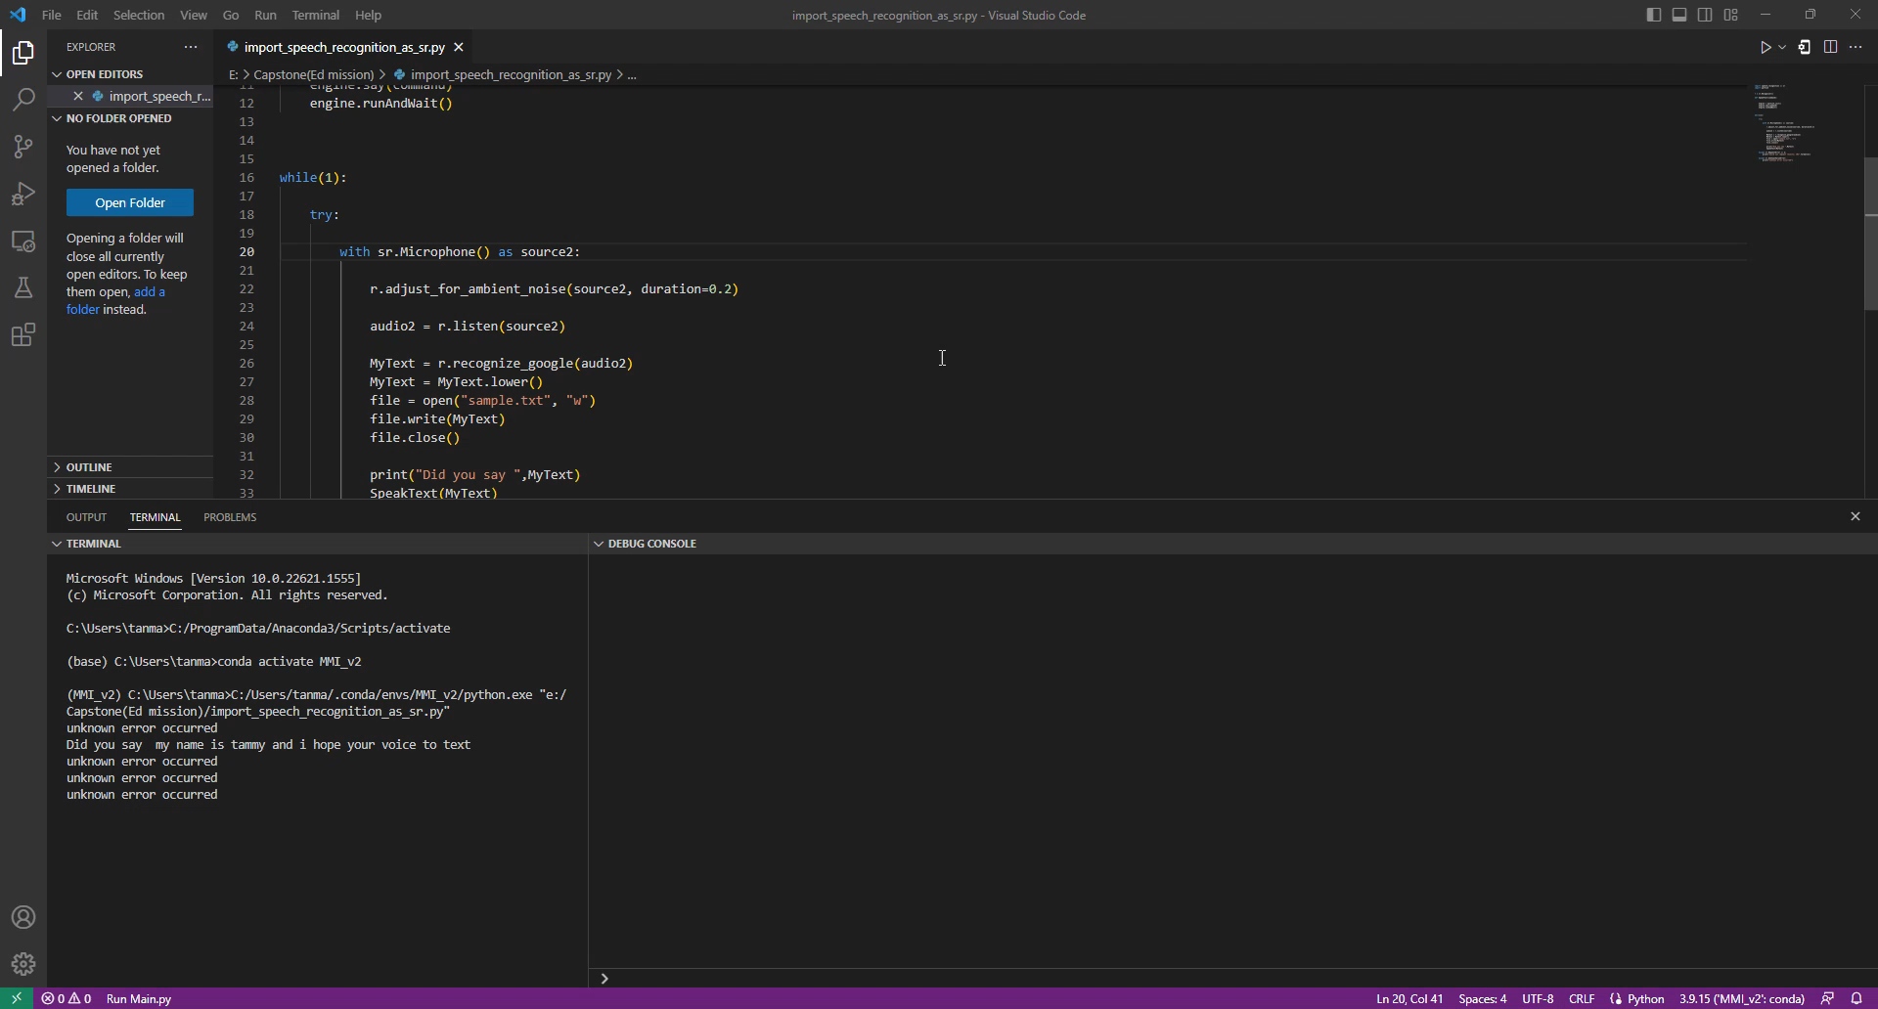
Voice To Text Demo

Slide 17
Face Detection
Technology and Its Role

Slide 18
Face detection technology will be used to analyze nonverbal cues during the interview process.
The face detection engine will be trained to recognize emotions, facial expressions, and other nonverbal cues.
The data collected from face detection will be used to assess the candidate's communication skills, confidence level, and overall fit for the program.

Slide 19
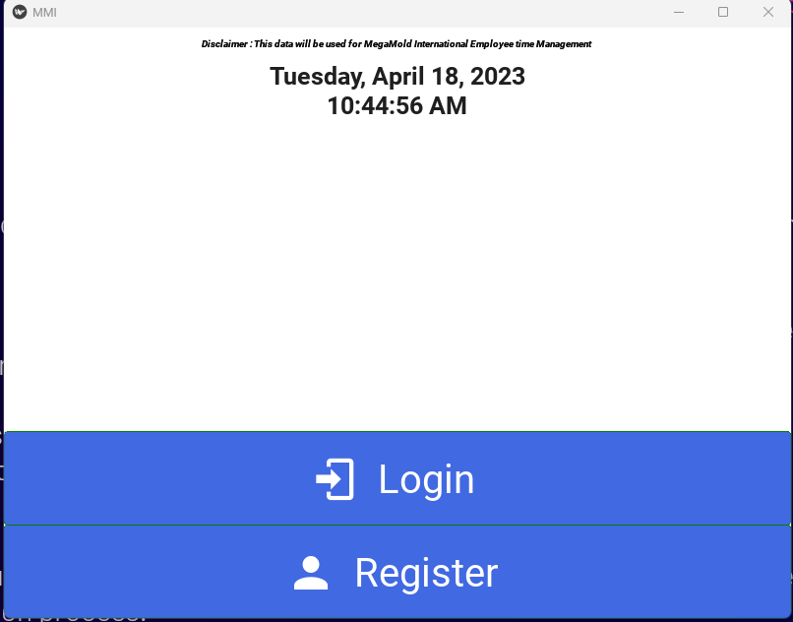
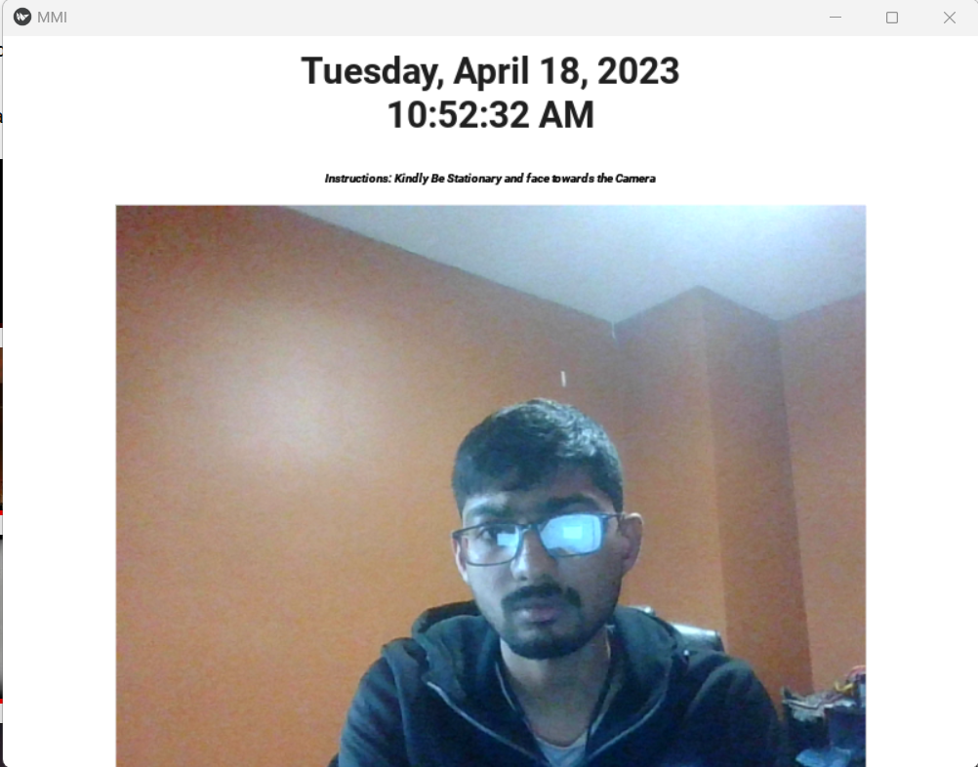
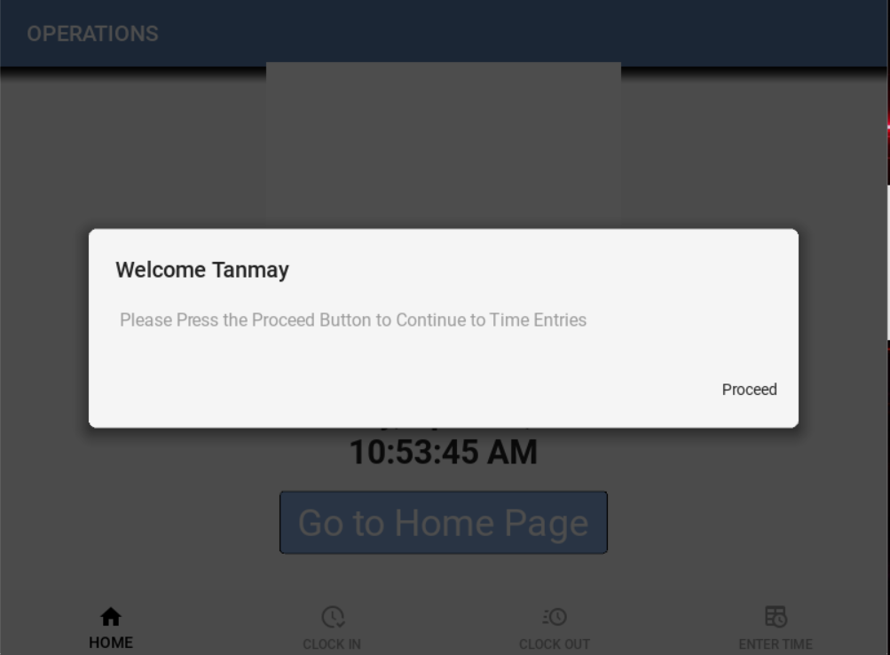
Models : we have used pre-trained models in this project such as CAFFEMODEL, liveness to predict the image and detect if the person on the screen real or fake.
Language and framework: The face recognition is developed on python and framework is KIVY on which this project is built.
Library and Machine learning concept : TENSORFLOW, KERAS ,SKLEARN,PANDAS,NUMPY,OPEN CV and we have used CNN for image classification and segmentation.

Slide 20
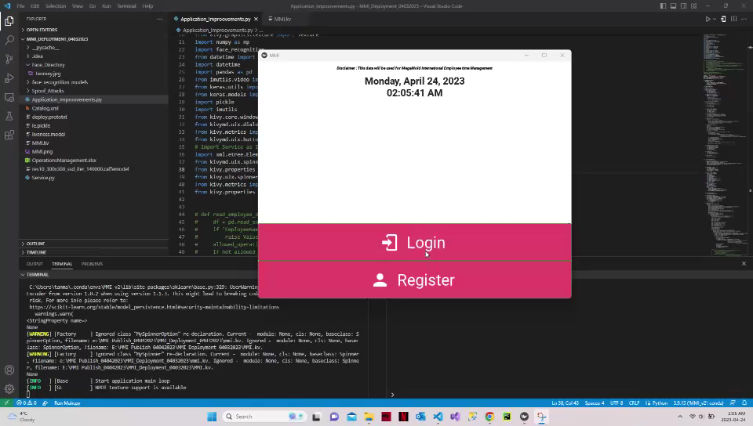
Face Recognition Demo

Slide 21
Challenges
The manual collection of data from official websites of colleges and universities was time consuming as they had many programs of different credentials.
One of the critical challenges in building AI and ML models for the university application process is the availability and quality of data. Due to high volume of courses and programs available in the manual data entry was required.
Team is constantly working on improving Google's voice-to-text API it is not always accurate. The accuracy of the transcription can be affected by various factors such as background noise, accents, and speech patterns.

Slide 22
Challenges
Voice Recognition Accuracy: Voice recognition technology can also be challenging, especially when dealing with accents, dialects, and background noise. Dealing with different microphone compatibility was another challenge that was faced. The system will need to be trained on a diverse set of voices to ensure accuracy and prevent bias.
Face Detection Accuracy: Face detection technology also faced challenges, especially when dealing with low-quality images, lighting conditions and facial expressions that can be misinterpreted. Ensuring that the models are trained on diverse datasets that represent the variability in facial appearances can be critical.
Integration and Compatibility: Integrating both the above-mentioned modules in a single application was another challenge as the combined unit testing was required. Combining this combined module with OCR was another challenge that was faced by the team.

Slide 23
Conclusion
The proposed solution will automate the student application assessment process for colleges and universities and make the application process easier and accurate for students.
It can speed up and simplify the review of applications, minimize manual work, and perhaps improve the fairness and accuracy of candidate selection.
Scalability, flexibility, and simplicity of integration with current systems may all be achieved by using cloud-based API solutions.
The cloud-based solution provided as an API will make it easy for colleges and universities to integrate the tool into their existing systems.

Slide 24
References
https://aisel.aisnet.org/cgi/viewcontent.cgi?article=1011&context=iceb2018
https://ieeexplore.ieee.org/document/9994112
https://www.sciencedirect.com/science/article/abs/pii/S1053482222000079
https://www.analyticsvidhya.com/blog/2021/07/face-key-point-recognition-using-cnn/
https://keras.io/guides/keras_cv/custom_image_augmentations/

Slide 25
THANK YOU!

